Slide 1

AI-Based Notes Summarizer & Cloud Share
A serverless application leveraging Amazon Comprehend and other AWS services.
Team Members: Raju Dhuriya, Mangesh Kanaujiya, Prince JaiswalDate: July 21, 2025
Trained Under: Mr. John (Senior AWS Trainer, Magic Bus Foundation), Guided by Swapnil Sir (Junior Trainer & Project Support)

Slide 2
Meet the Team
Raju Dhuriya
Cloud & DevOps Lead
Designed and deployed serverless architecture on AWS.
Implemented CloudFormation for infrastructure as code.
Managed AWS services including S3, Lambda, DynamoDB, and Route 53.
Mangesh Kanaujiya
Frontend Developer
Built responsive and animated web UI using HTML, CSS, and JavaScript.
Integrated frontend with AWS API Gateway and other AWS services.
Prince Jaiswal
Backend Developer
Developed Lambda functions for secure uploading and efficient summarization of notes.
Managed error handling, comprehensive logging, and audio summary generation.

Slide 3
Project Introduction
Our goal is to build a cloud-native web application that leverages Artificial Intelligence to generate instant summaries from uploaded notes (PDF or text), making them accessible and shareable through the cloud.
Upload Notes
AI Summarization
Users can easily upload .txt or .pdf files into the system.
Amazon Comprehend powers high-quality, accurate summaries.
Cloud Storage
Fully Serverless
Summaries are securely stored and retrieved using Amazon DynamoDB.
Built entirely with AWS Serverless technologies for infinite scalability and zero maintenance overhead.

Slide 4


The Problem
In today's digital world, individuals constantly navigate vast amounts of information, from academic notes and meeting summaries to extensive research papers and detailed reports.
Key Problem: Time-Consuming Manual Summarization
Users spend countless hours reading and condensing long texts, a process that is both inefficient and mentally taxing.
This burden is particularly acute for students preparing for exams and busy professionals managing extensive documentation.

Slide 5

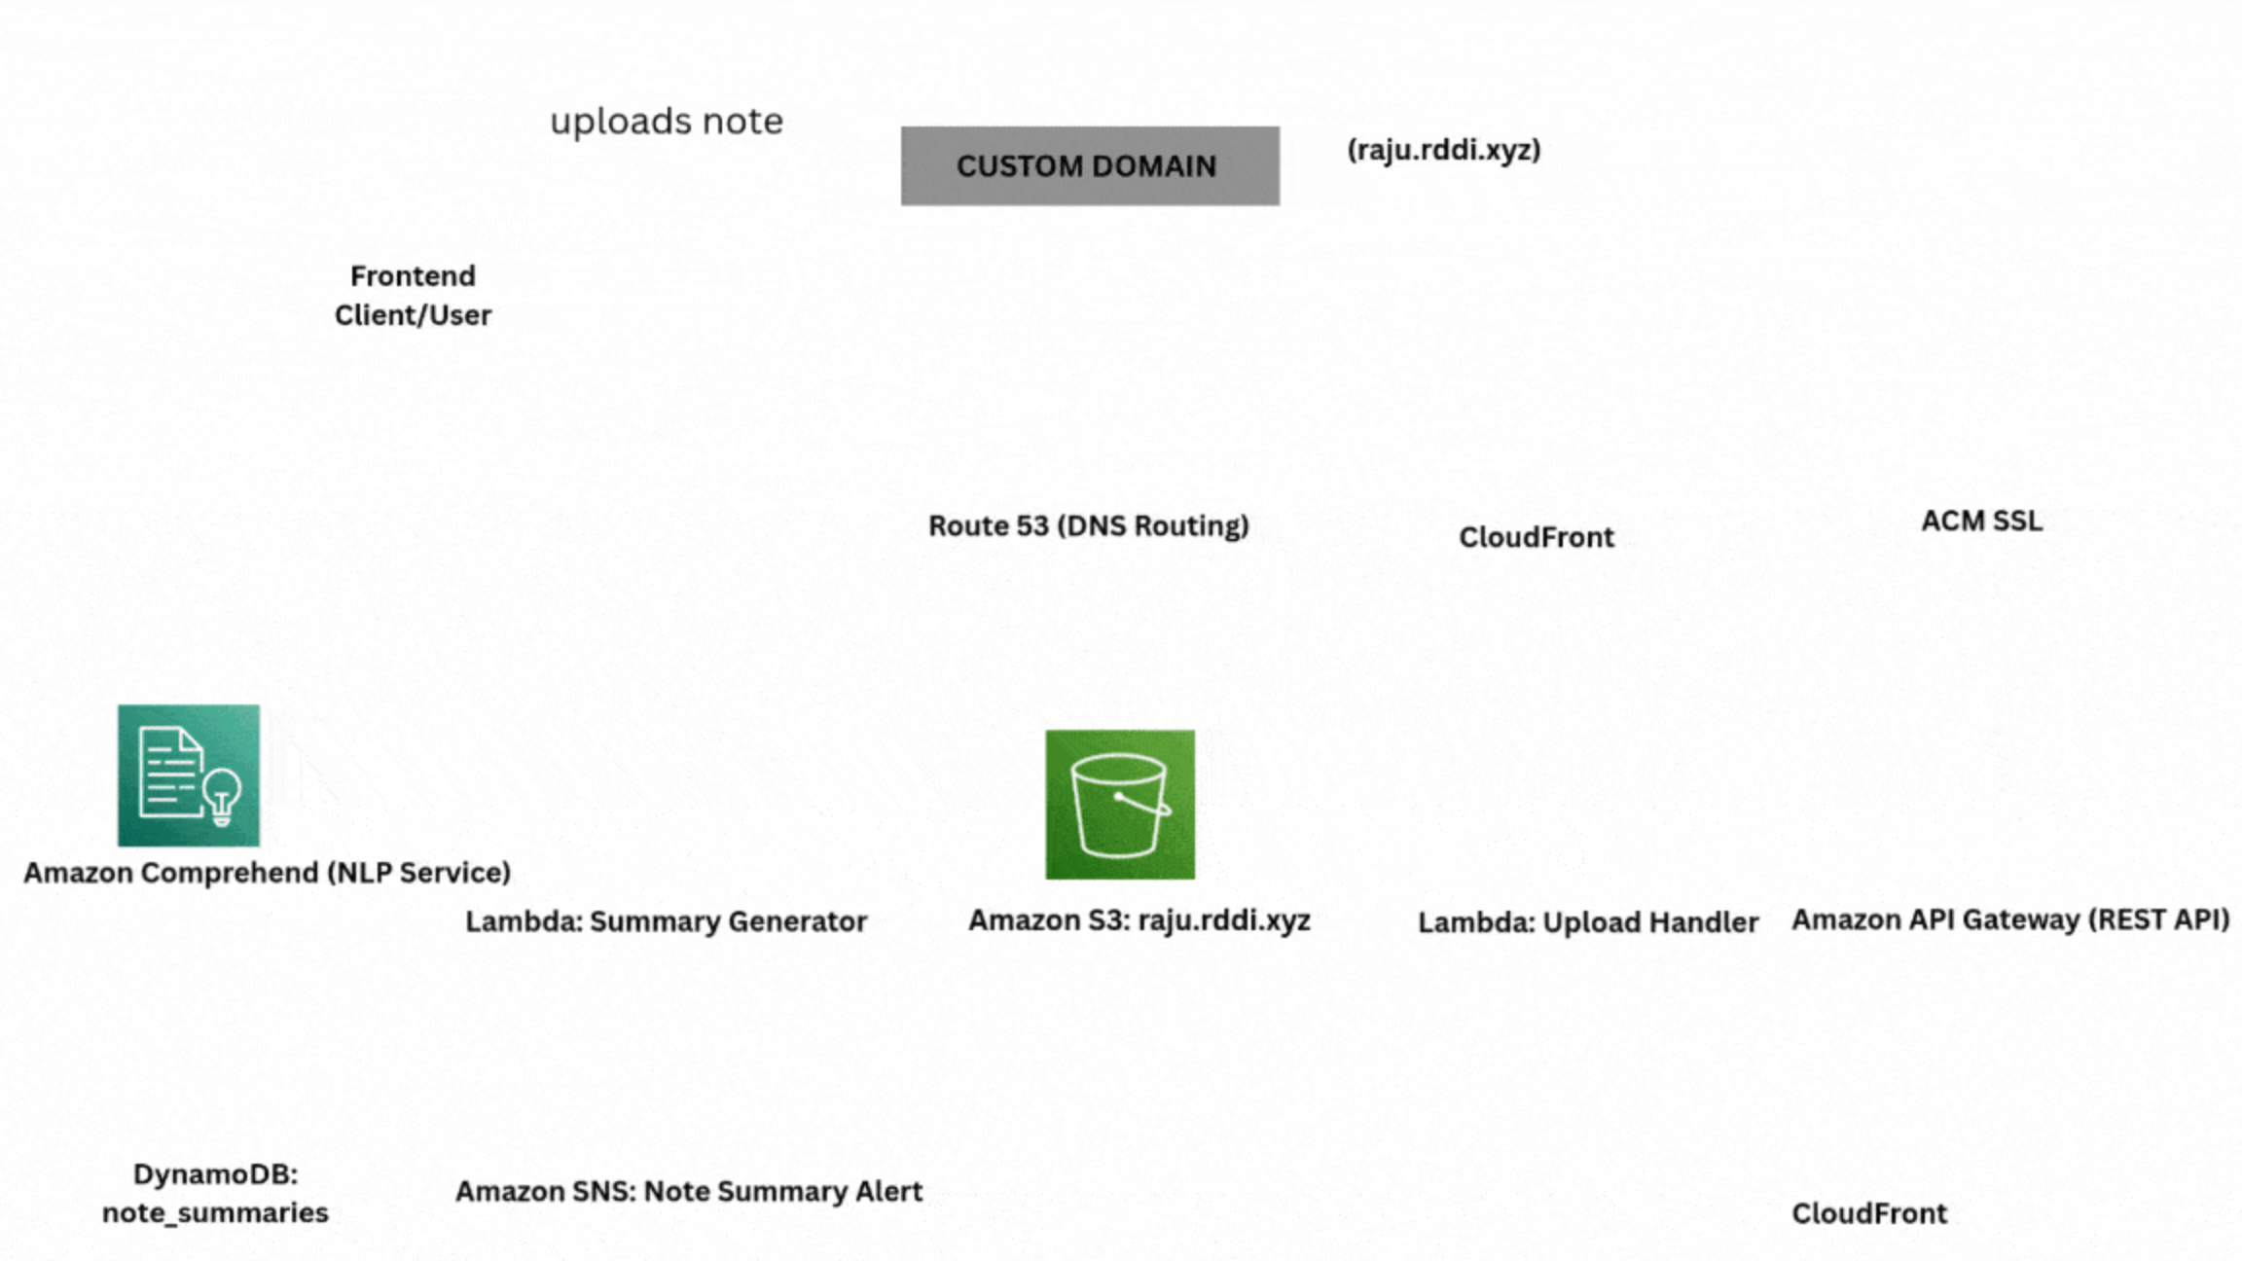
Project Architecture Diagram
Our serverless architecture leverages AWS services to provide a scalable and efficient note summarization solution. Files are uploaded to S3, processed by Lambda functions leveraging Amazon Comprehend, and stored in DynamoDB, all orchestrated via API Gateway.

Slide 6
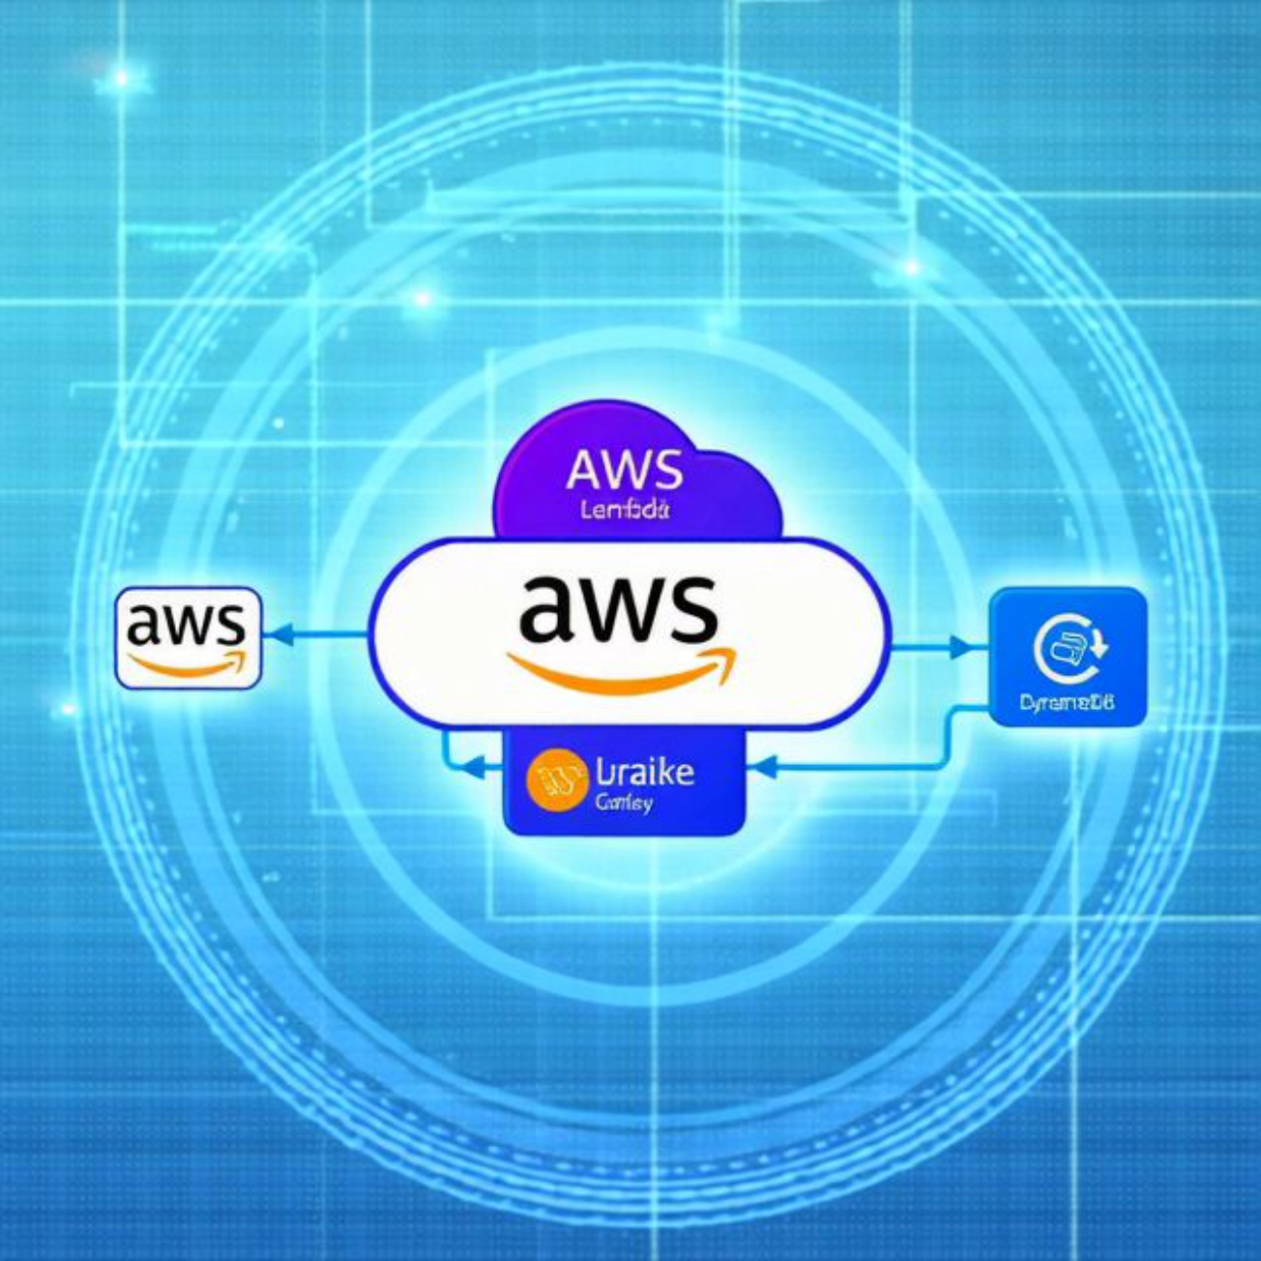
Technology Stack
Frontend: HTML, JavaScript for a dynamic user interface. Backend: AWS Lambda for compute, API Gateway for API management.
Storage: Amazon S3 for file storage, DynamoDB for structured data.
AI: Amazon Comprehend for advanced text summarization. DevOps: CloudFormation for infrastructure as code automation.
Monitoring: CloudWatch for comprehensive logging and real-time alerts.
Supporting Services: Route 53 (DNS), IAM (Access Management), CloudFront (CDN), ACM (Certificate Management), SNS (Notifications).

Slide 7
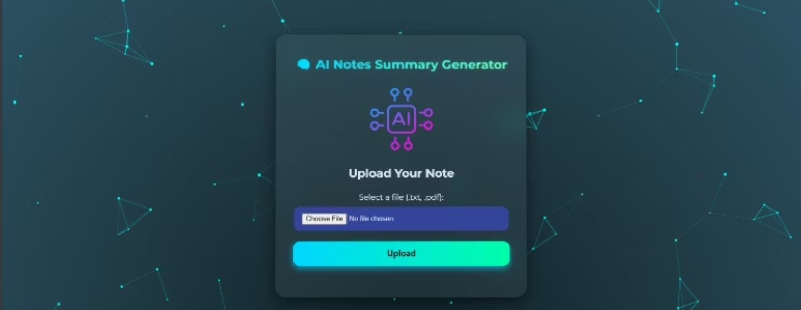

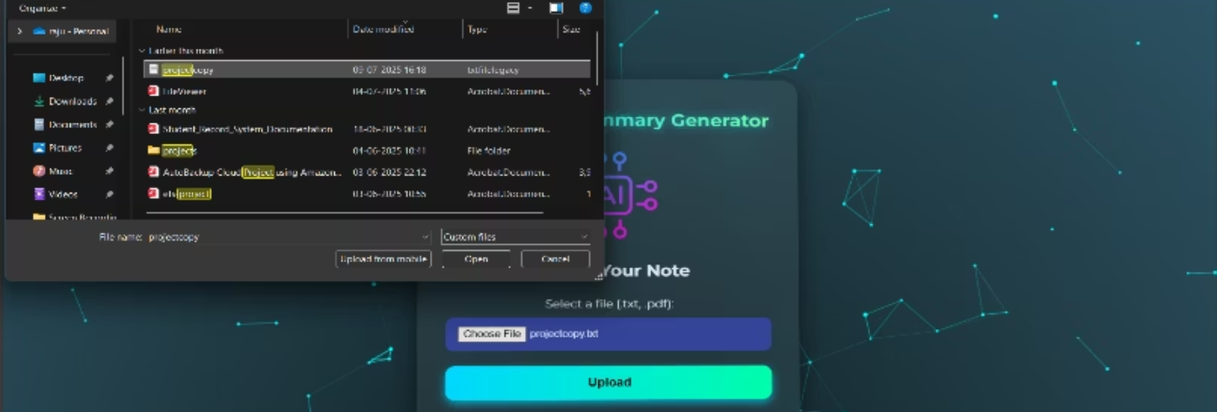
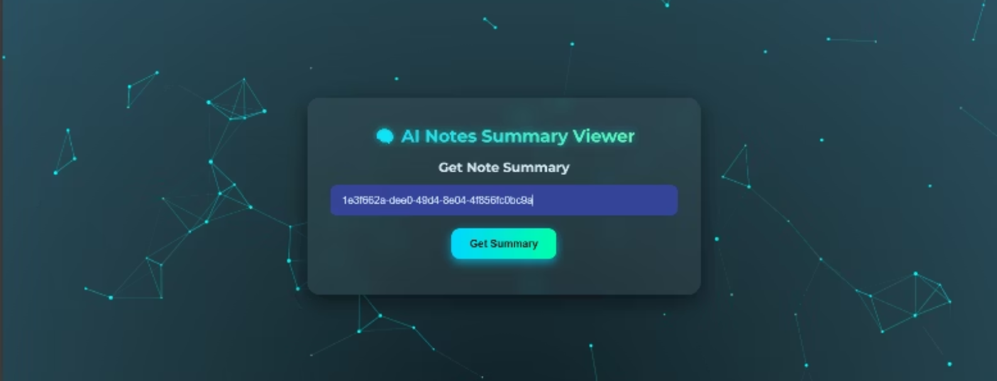
Project Demo
Experience the live application:Click here to visit our website

Slide 8



Challenges & Solutions
Large PDF Extraction
AI Latency
Secure Access
Addressed with robust frontend pdf.js processing and a reliable Lambda fallback mechanism for complex documents.
Minimized through optimized asynchronous processing utilizing AWS Lambda and Amazon SNS for efficient task orchestration.
Ensured robust security using finely-tuned IAM roles and stringent API Gateway authorizations.
"We overcame common cloud challenges to deliver a smooth user experience."

Slide 9





Future Enhancements
Multi-language Summarization
Mobile App Integration
Expanding Amazon Comprehend's capabilities to support diverse languages for broader global reach.
Developing native iOS and Android applications for on-the-go summarization and access.
Real-time Collaboration
Analytics Dashboard
Implementing features for collaborative editing and instant sharing of summaries among users.
Providing users with insights into their document usage and summarization patterns for enhanced productivity.
"We plan to expand features to increase usability and engagement, continuously evolving to meet user needs."

Slide 10
Conclusion
Automated note summarization drastically saves time and boosts efficiency.
Our scalable, serverless, cloud-based architecture ensures reliability and cost-effectiveness.
AI integration empowers users to access knowledge faster and more efficiently.
The project demonstrates great potential for transforming learning and professional workflows.
"Our project brings AI and cloud together to empower note-taking, making information more accessible than ever before."

Slide 11


Thank You
We extend our sincere gratitude to Mr. John, Senior AWS Trainer, for his invaluable guidance that demystified complex cloud concepts. We also thank Swapnil Sir for his continuous technical support and mentorship throughout this project.

